Slide 1
Weekly meeting
11 21 2024
Ty Bottorff

Slide 2
Outline
NCI progress
baseline features frequencies delineating specific irAEs!
IMPACD validation
AbATE: brainstorming combining manuscripts w/ Josh

Slide 3
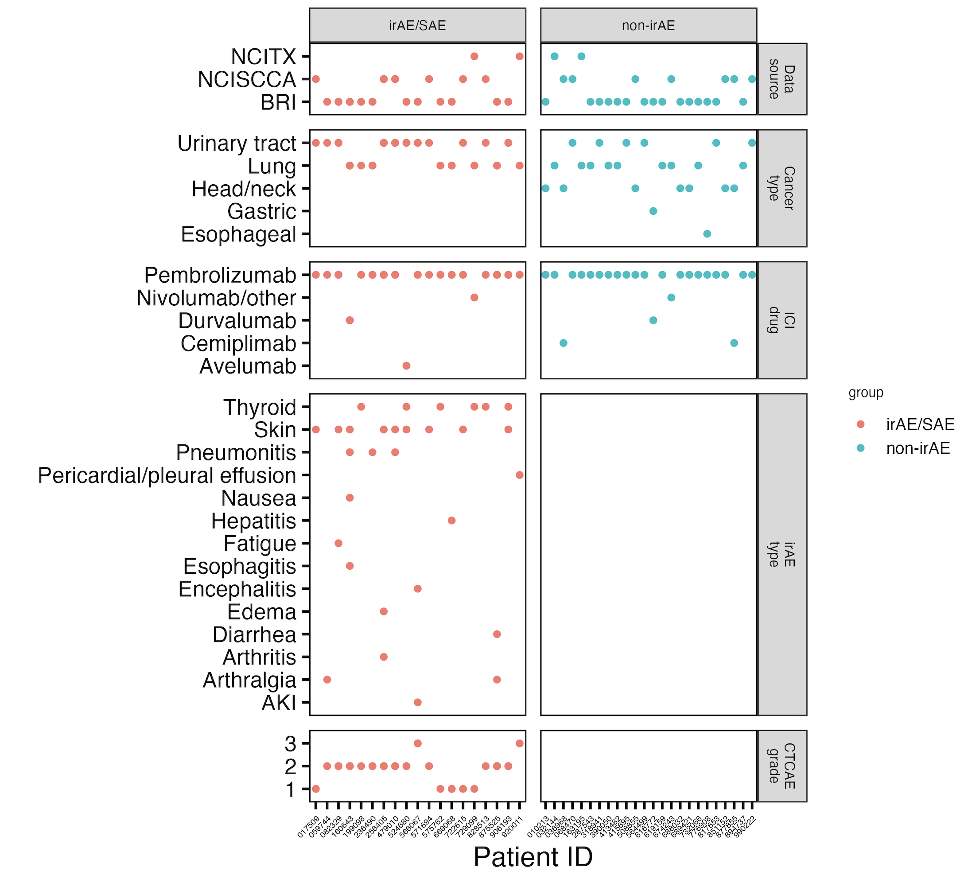
Updated NCI irAE cohort summary
Notes:
Was able to move unspecified irAEs to specific ones, this helped me actually test pneumonitis/rheumatoid and likely contributed to ~different results I now see for skin/thyroid as well!!
Still not sure why head/neck no irAEs… Holly proposed that this may be a less aggressive cancer…

Slide 4
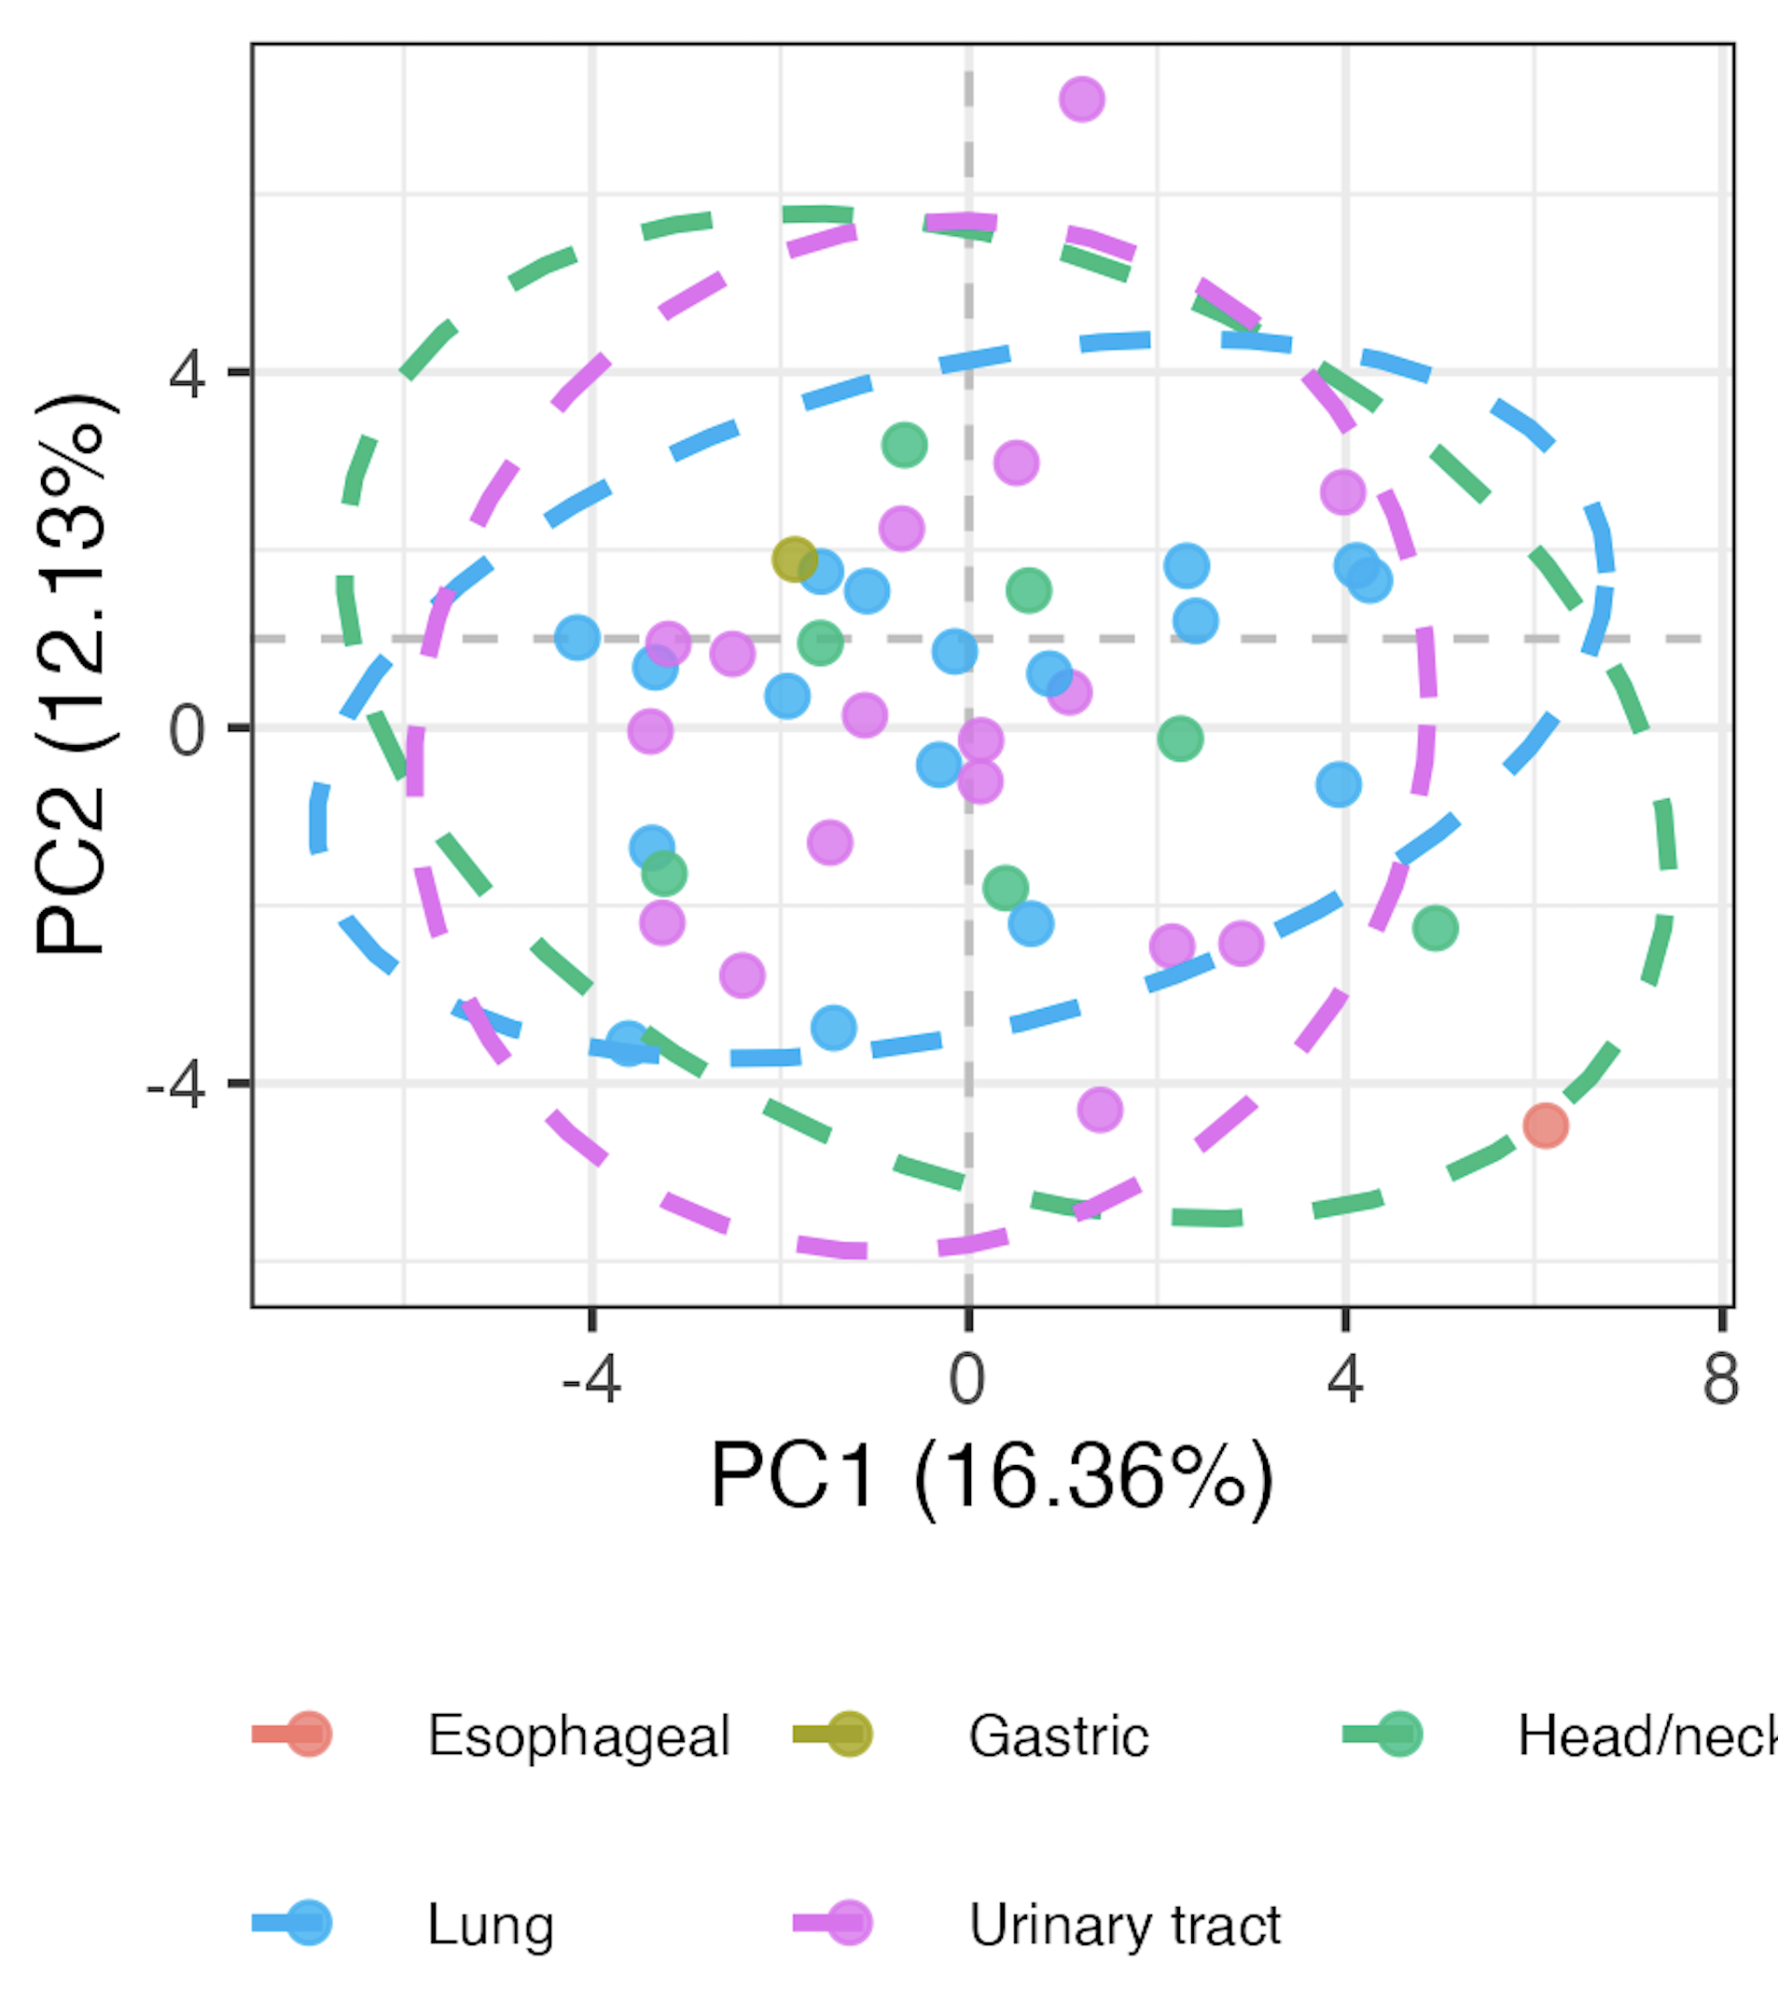
Baseline immunotypes do not greatly differ by primary cancer type

Slide 5
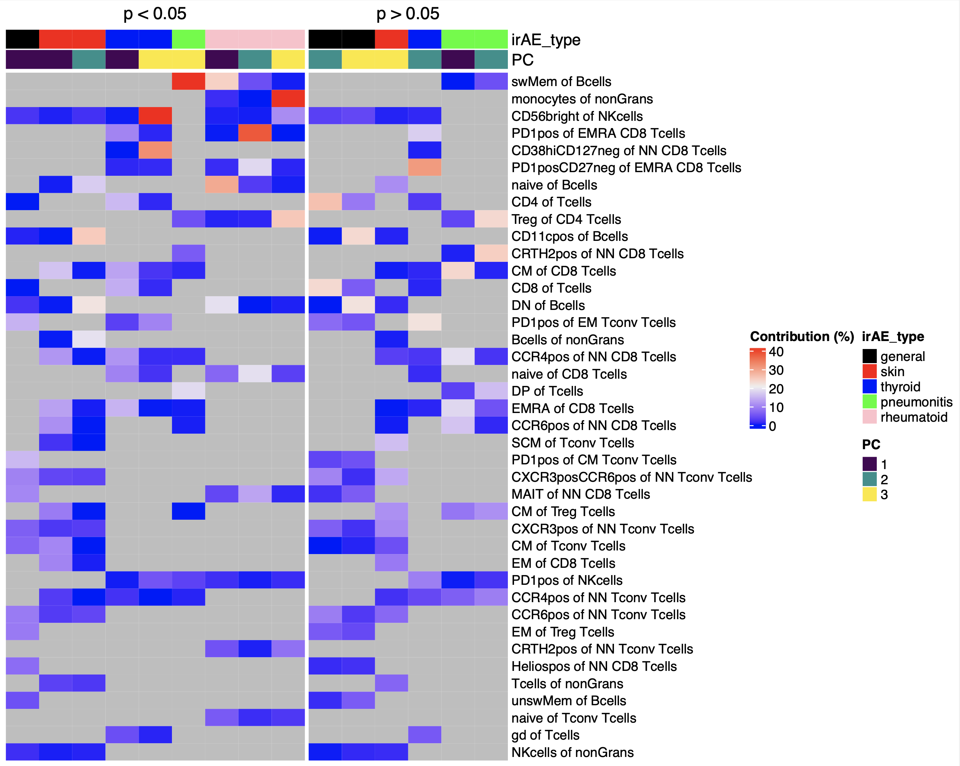
Some features are more irAE-type specific (baseline immunotypes)
Notes:
Significance (p) here is from testing if a specific irAE type differs in that PC#
Features chosen by unadjusted pval < 0.2 to get more features and have less NAs ideally for each irAE type yes vs. no
This isn’t concordant really with Bukhari paper that showed CD4 subsets and CD8 Tcm results (I don’t know what would correspond to CD4 subsets here AND for their arthritis CD8 TCM that’s not a contributing feature here to rheumatoid

Slide 6
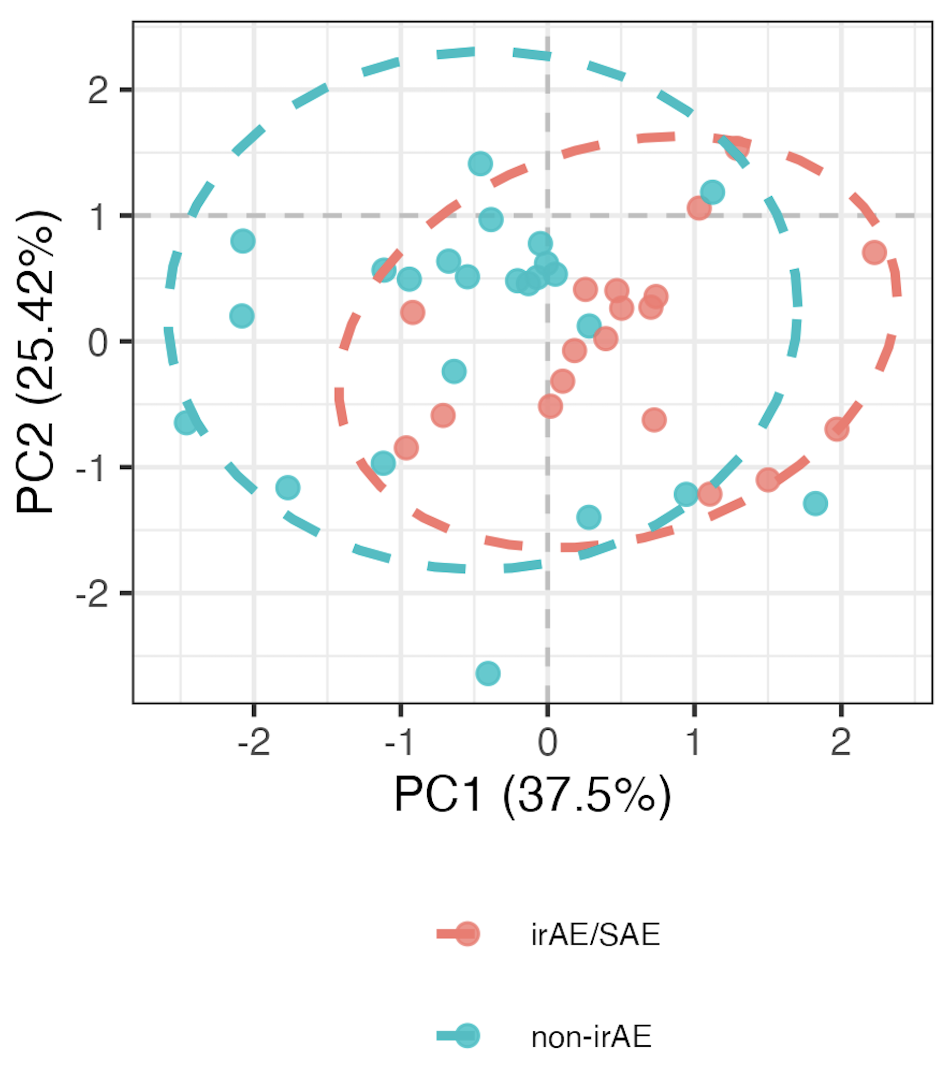
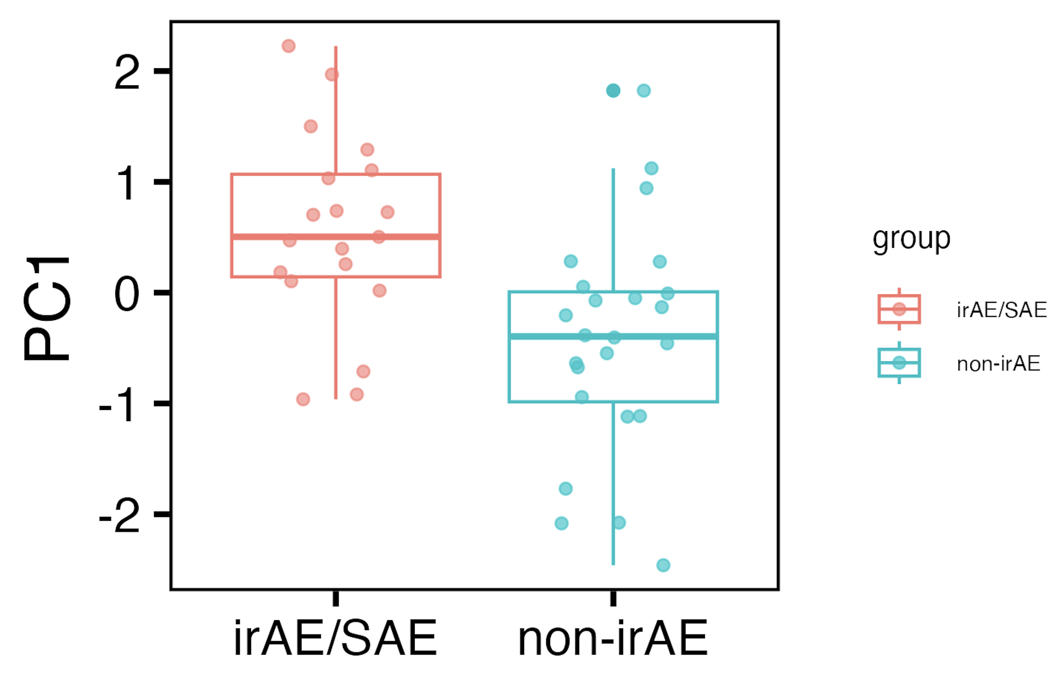
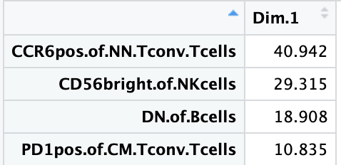
For general irAEs, whittled down to 4 features (other combinations of > 4 also work)
P = 0.001
Notes:
Other feature combinations definitely also discriminate immunotypes though…

Slide 7
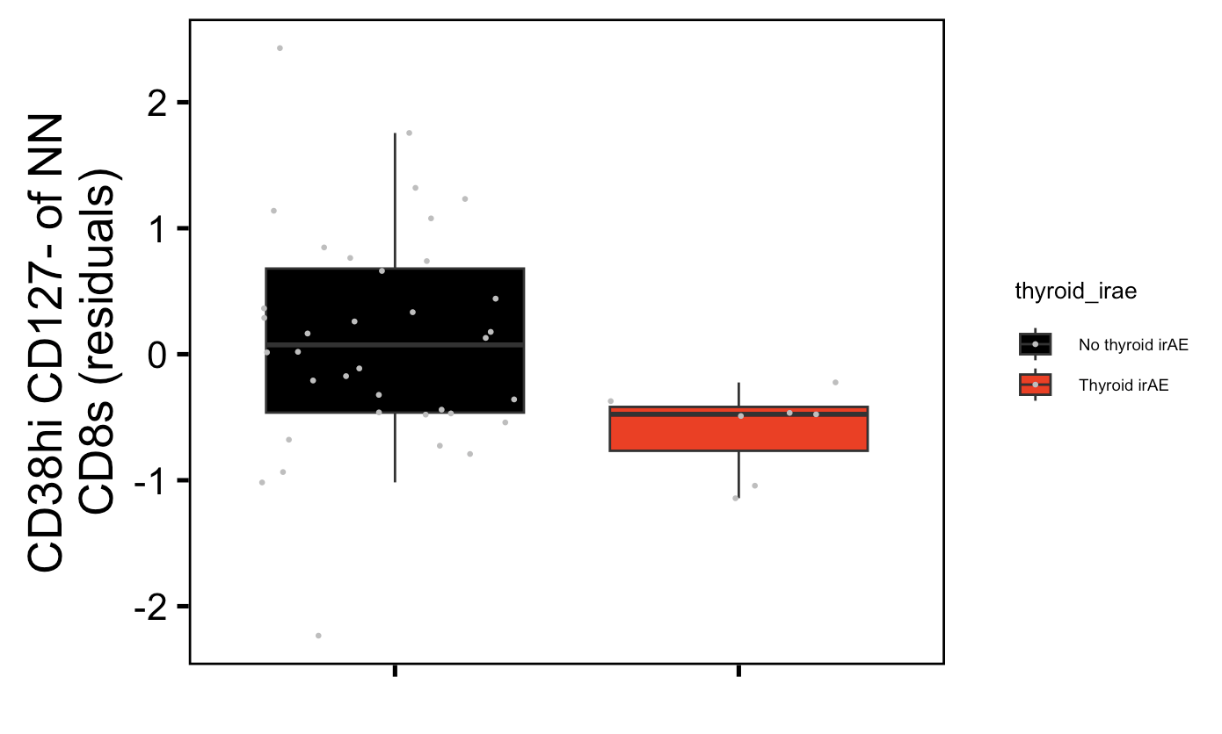
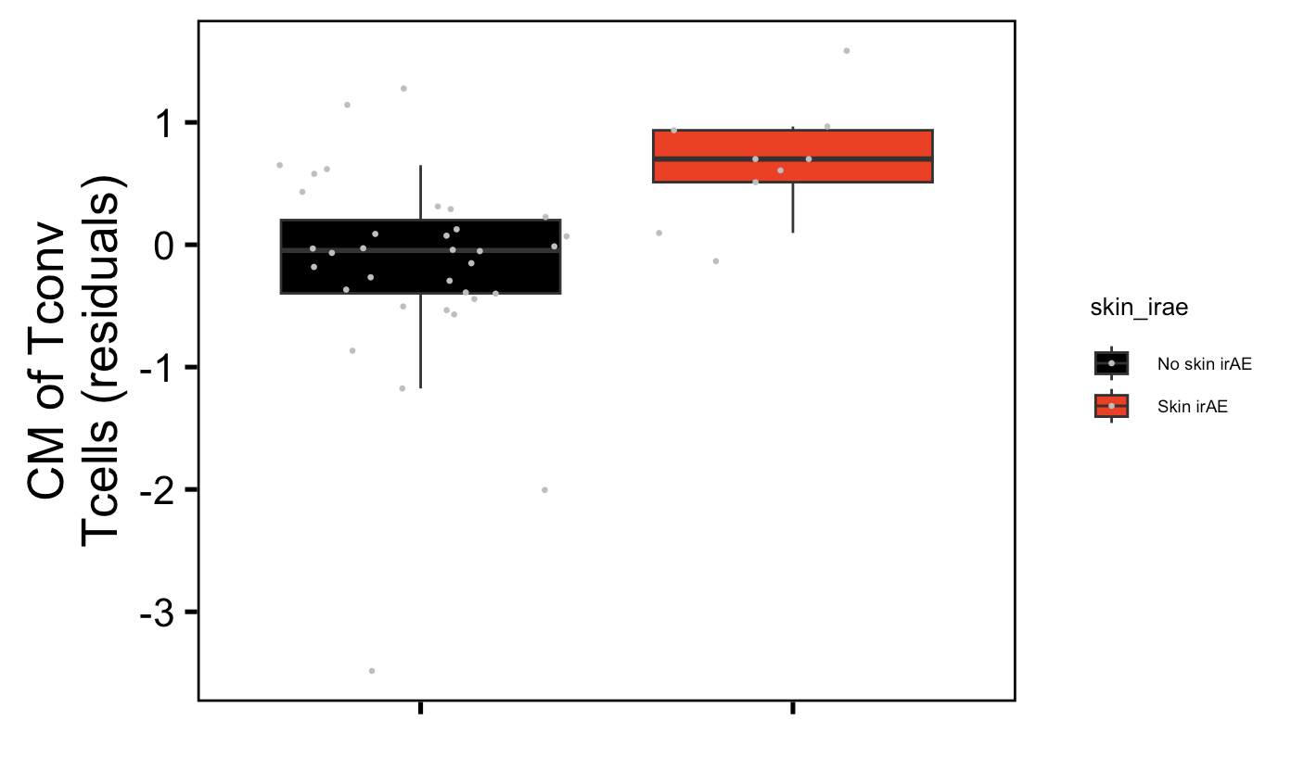
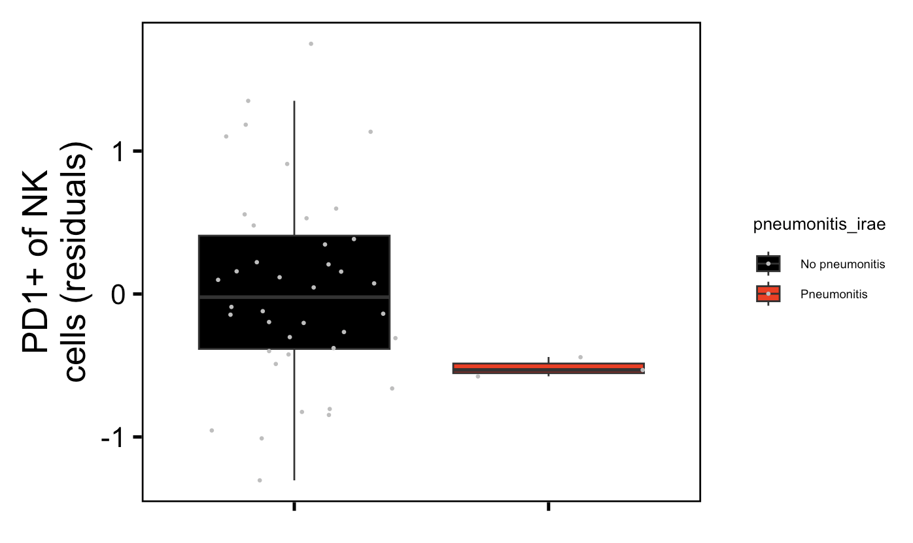
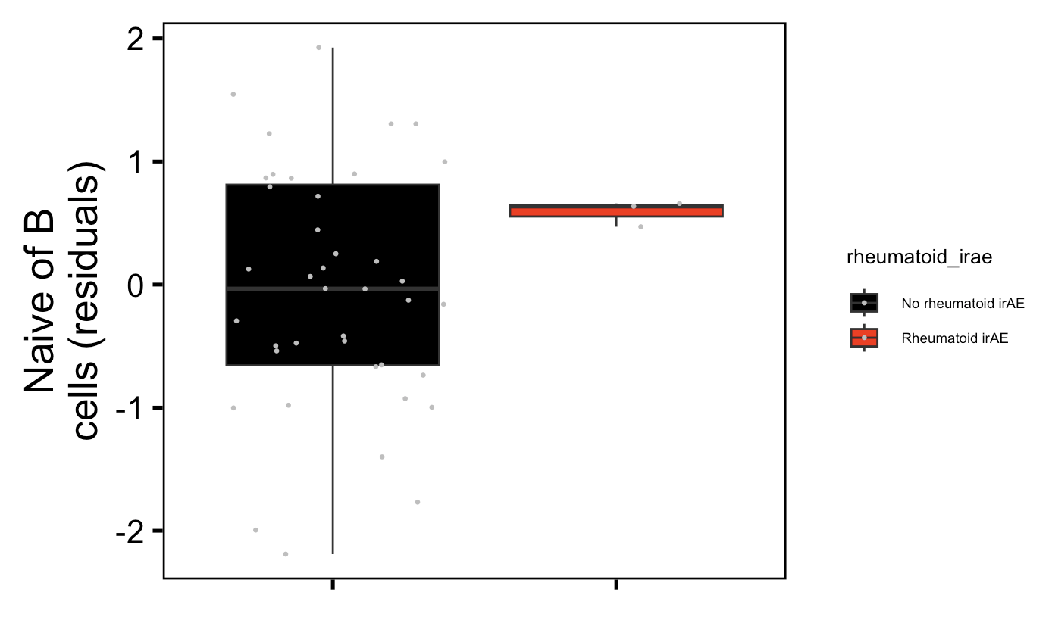
For some specific irAEs, a few features’ freqs appear distinct between groups at baseline!
Thyroid (n = 7): padj = 0.07
Skin (n = 9): padj = 0.04
Pneumonitis (n = 3): padj = 0.001
Rheumatoid (n = 3): padj = 0.03
Notes:
43 total subjects
I think contributing to not seeing this until now was the unspecified irAEs that then added to these categories…

Slide 8
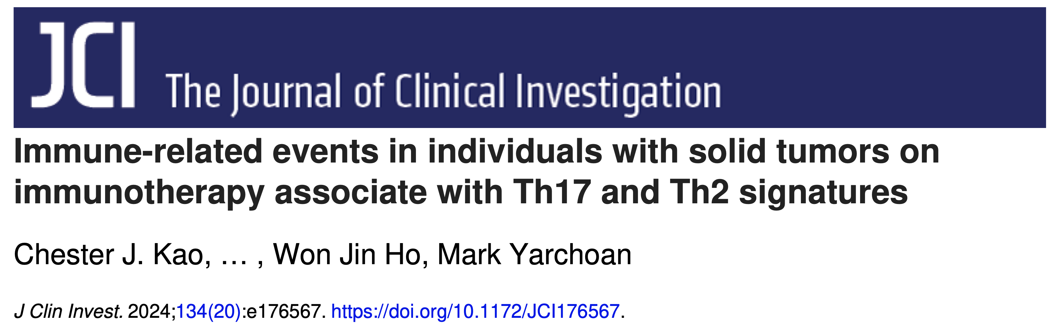
1 potential dataset with necessary features to test 4 feature module (for general irAEs) in
Notes:
Has CCR6, PD1, CD56…
But doesn’t have data easily accessible

Slide 9
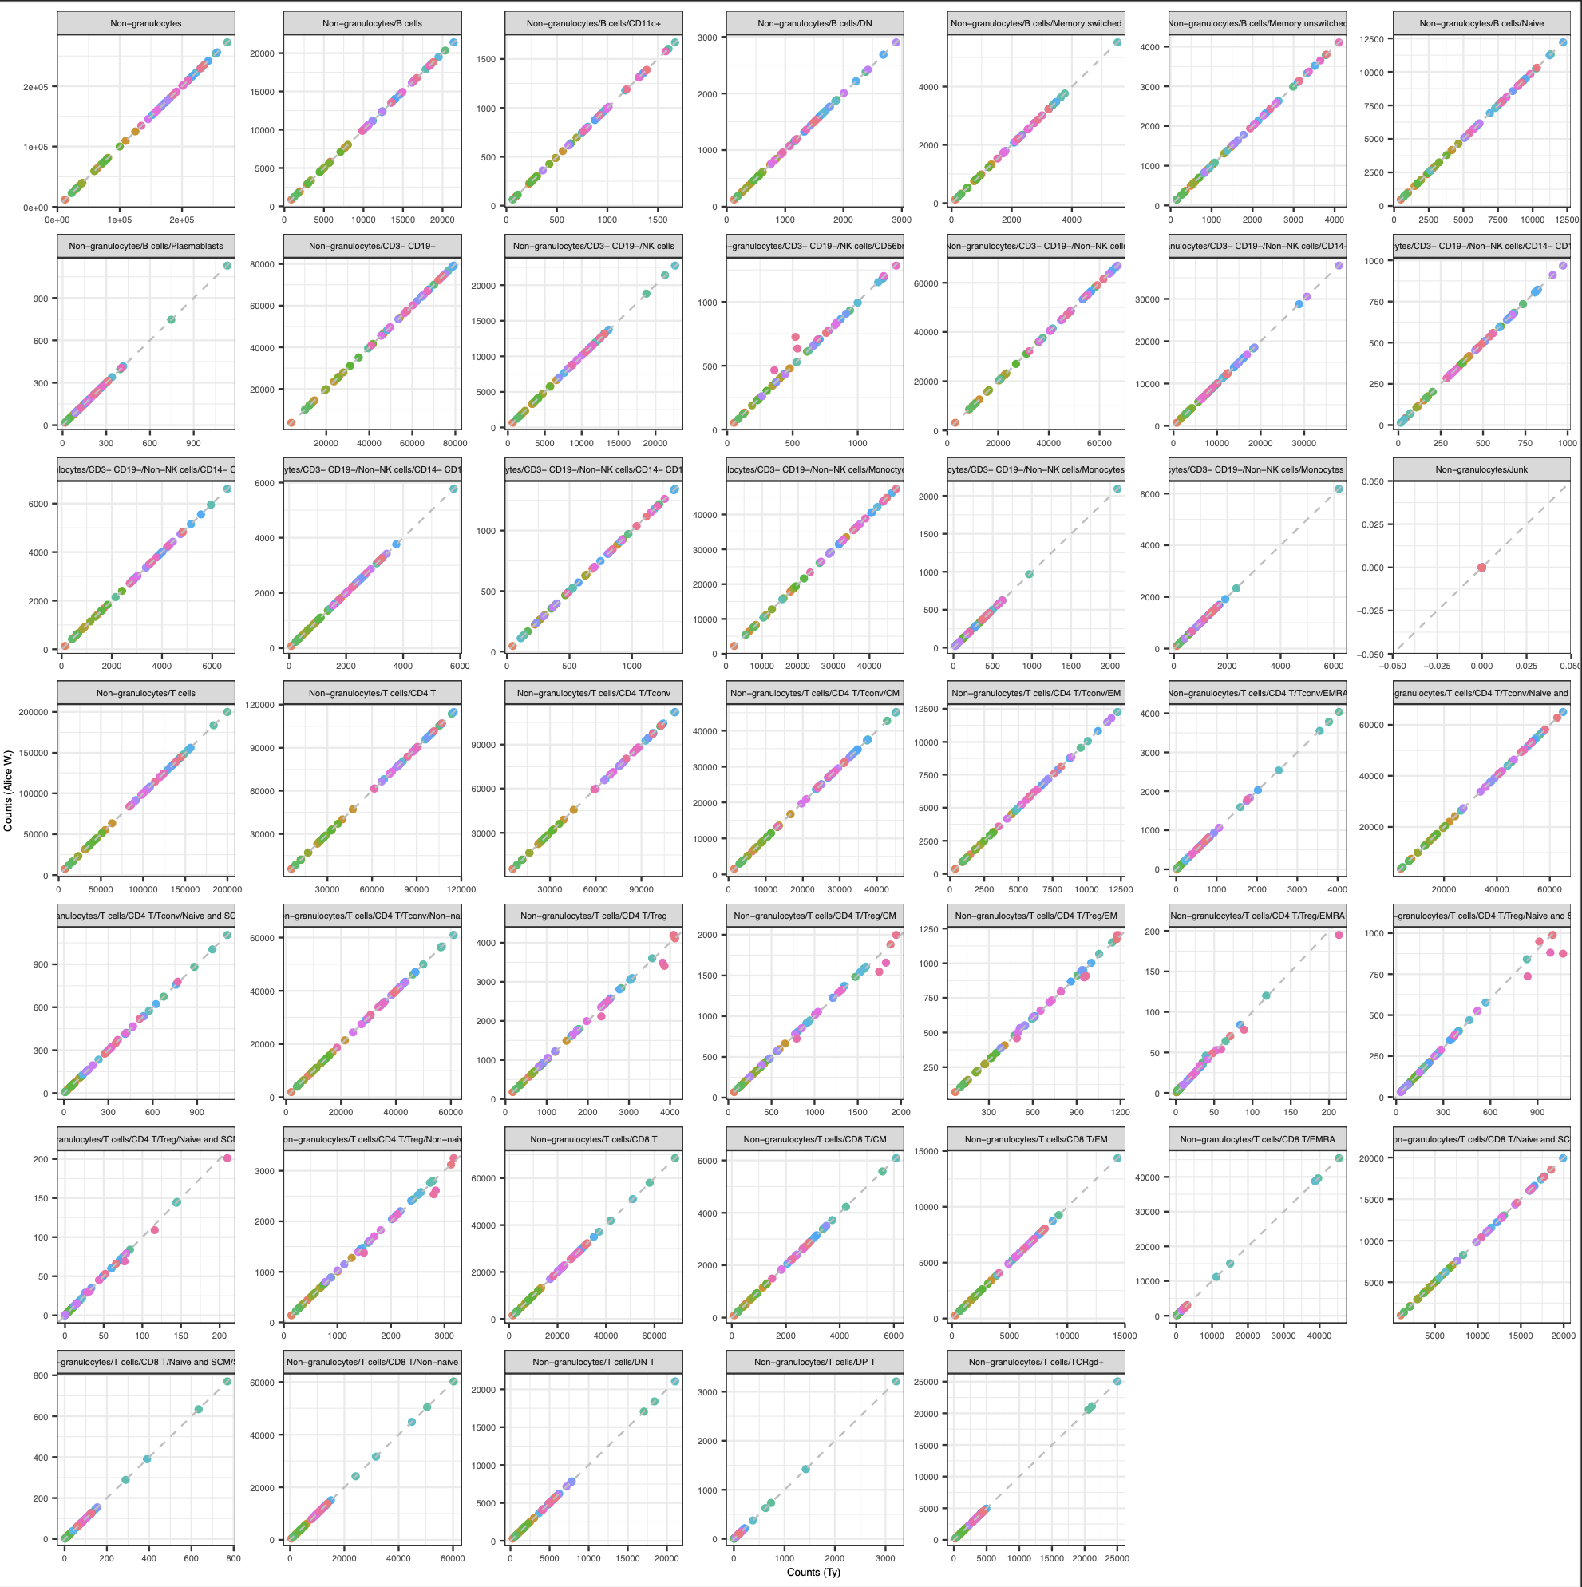
IMPACD: some discrepancies between Alice W.’s cell counts & my cell counts

Slide 10
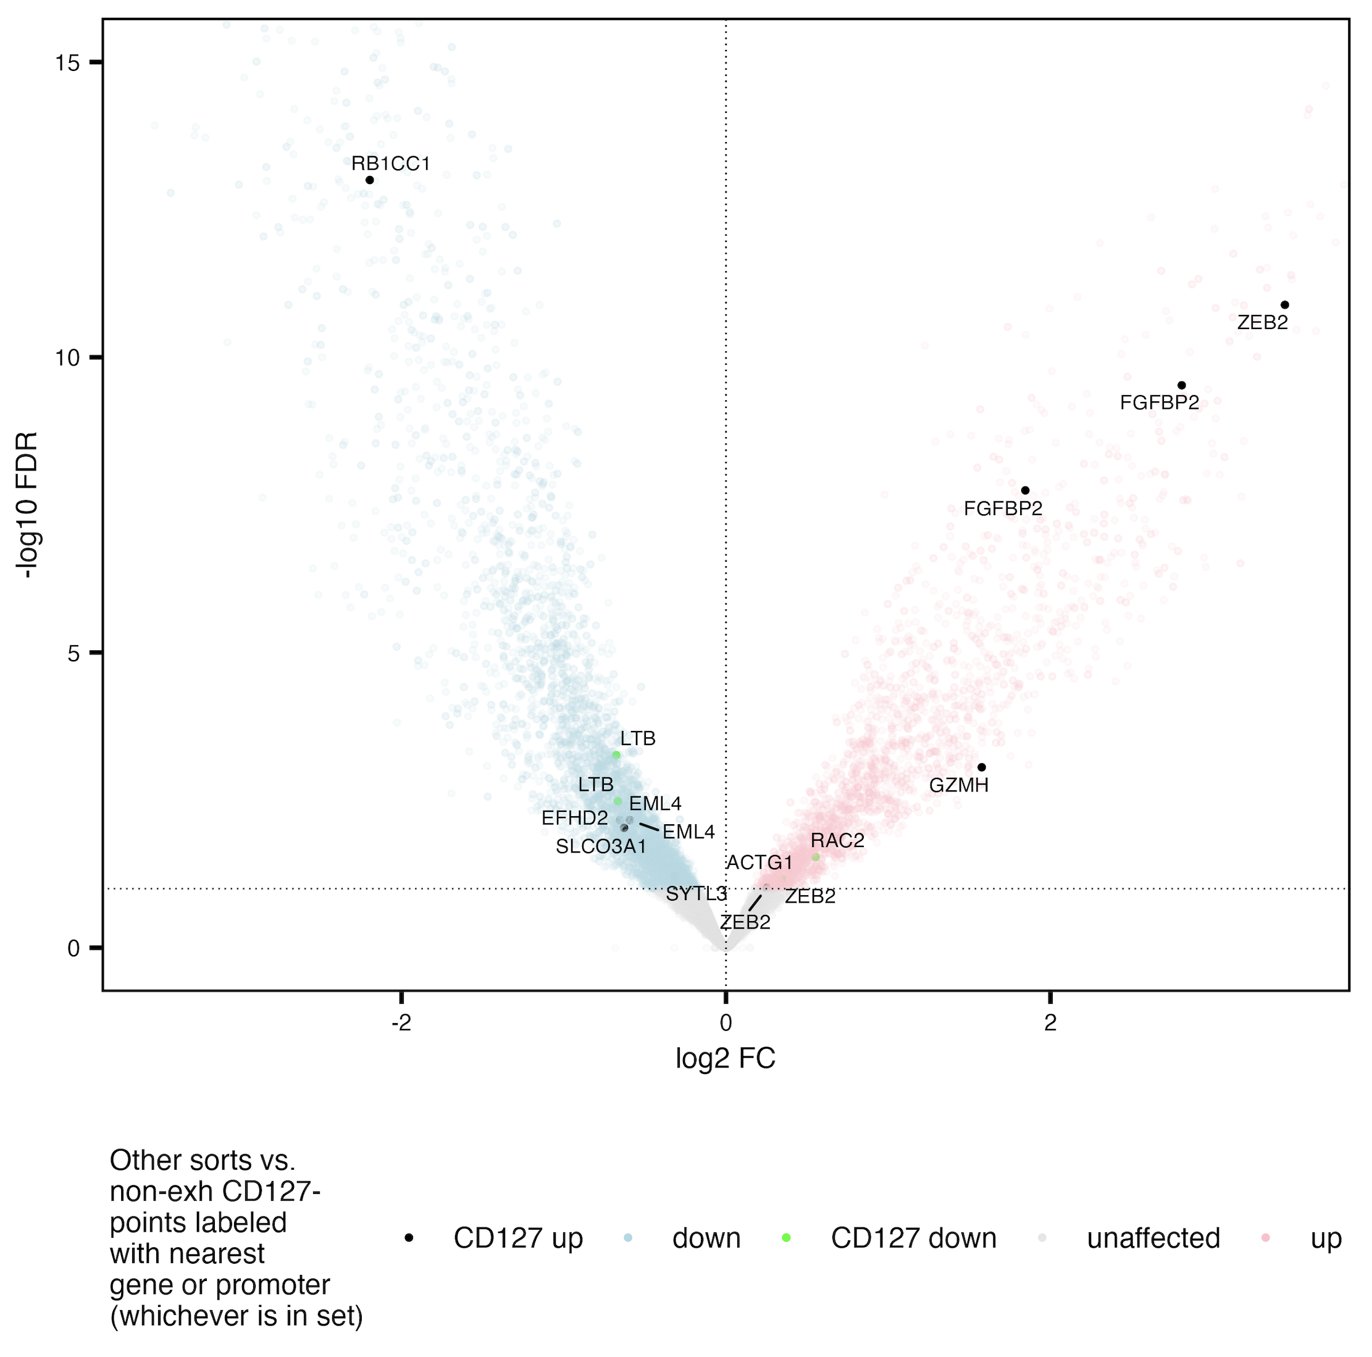
Gene sets from Josh’s figure 4B (scRNAseq of TIGIT⁻CD127⁺ vs. others) don’t show concordance with accessibilities in non-exhausted CD127⁺ in AbATE
Notes:
Maybe due to non-exh here including TIGIT+KLRG1-CD127+ which they don’t include in theirs…

Slide 11
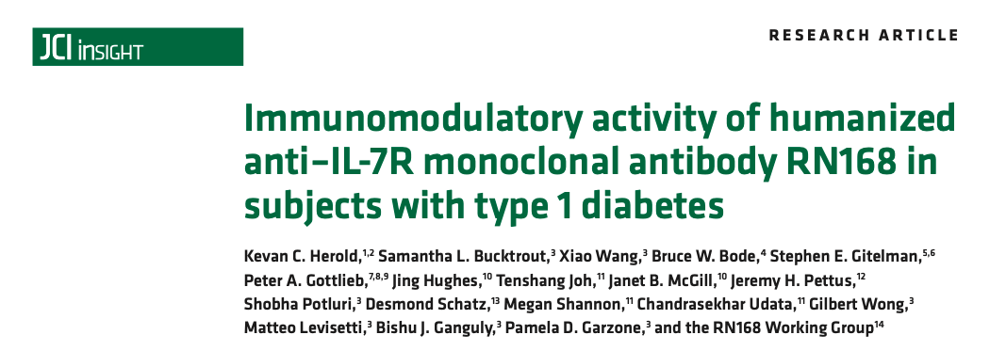
Bulk RNAseq of CD8s at baseline and 85 days on IL7R blockade
They did not see significant differences in PD-1 expression in CD8s after IL7R blockade
Could potentially look at TIGIT, KLRG1, B3GAT1…
Data not readily available, would need to ask Kevin Harold/others

Slide 12
Conclusions
NCI irAE: some features show frequency differences for specific irAE type comparisons (baseline analyses)
CD38^{hi}CD127⁻ of NN CD8s (thyroid)
CM of Tconv (skin)
PD1⁺ of NKs (pneumonitis)
Naïve of B cells (rheumatoid)
Combination of a few features’ frequencies can distinguish between (general) yes vs. no irAE
AbATE:
do not see concordance b/w RNAseq gene set of TIGIT⁻CD127⁺ and ATAC accessibilities of not DP CD127⁺

Slide 13
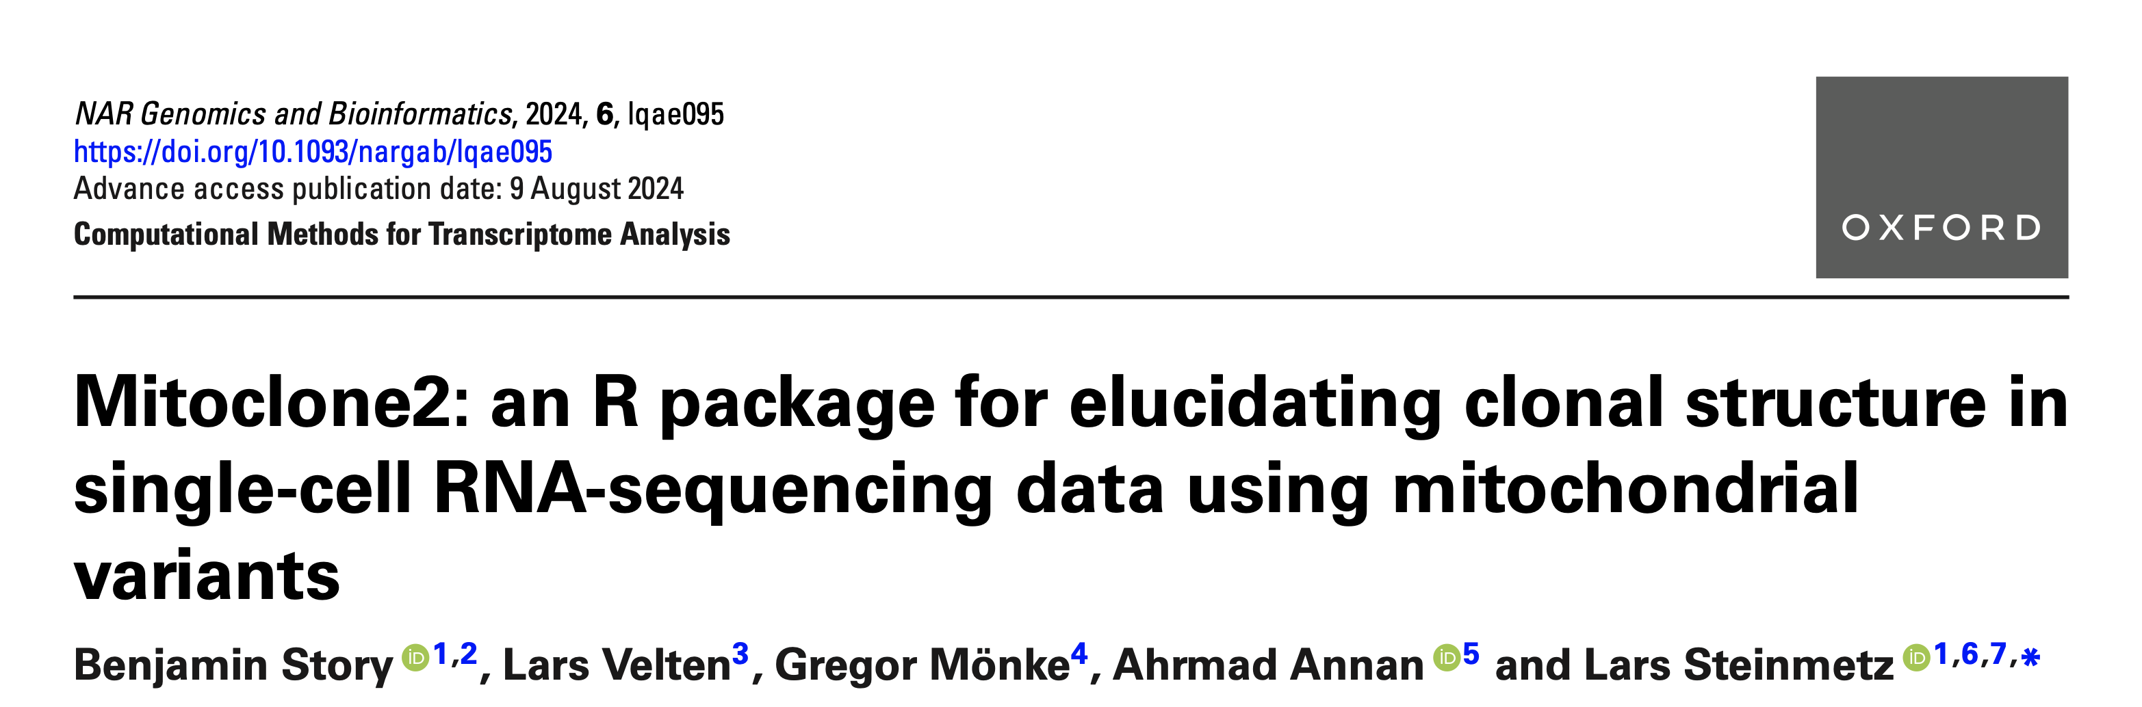
Next steps
NCI irAE
IMPACD: resolve discrepancies in counts, then proceed to hierarchical gating and comparing counts b/w irAE (general/specific) groups at baseline
test baseline general irAE module in public datasets
AbATE: think about how to combine manuscripts w/ Josh
identify MT SNVs from scRNAseq in P384 (Josh’s/Basilin’s scRNAseq)
use CITEseq markers to identify DP PD-1⁺/CD57⁺ populations (in addition to TIGIT⁻CD127⁺ one)
compare lineages identified by MT SNVs to those identified by TCR clonotypes

